Slide 1
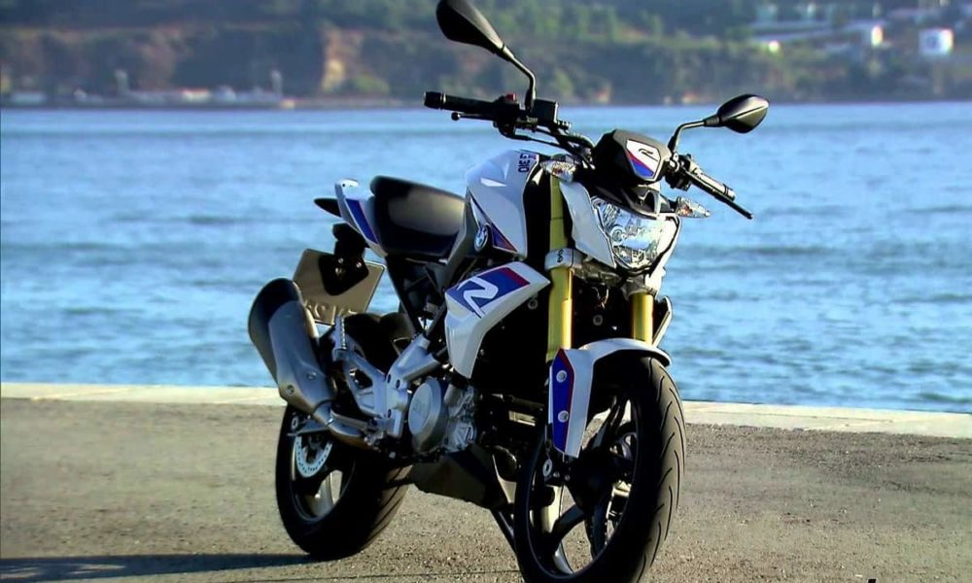
Bmw G 310 GS BIKE DATA ANALYSIS
BY:
S.MADHAN KUMAR

Slide 2

BMW G 310 GS
PRICE : 2.65LAKH
DISPLACEMENT : 313CC
TOP SPEED : 145

Slide 3
TARGET:
BMW TARGETS CUSTOMERS FROM UPPER CLASS SOCIAL GROUP AS THEYARE THE PEOPLE FOR WHOM BMW WILL BE AFFORDABLE & MOREOVER THEY WILL APPRECIATE THE MASTERPIECE.
AGED
50-65
MOST COMMONLY
MALE
30-49
MID AGE
18-29
YOUNG AGE

Slide 4

HYPOTHESIS TEST
1.X = AGE AND Y = NO. OF. BIKE SALES
2.ALPHA VALUE=0.05
3.2 SAMPLE T TEST
4.H0=MUA EQUAL TO MUB , H1= MUA NOT EQUAL TO MUB
5.P VALUE= 0.236264
6.P=0.236264 ALPHA=0.05
7.P>ALPHA P IS HIGH
8. NULL IS ACCEPTED
9. NO.OF.BIKE SALES BY THE PERSONS DOESN’T DEPENDS ONLY UPON
THE AGE GROUP.IT DEPENDS ONLY UPON THEIR INTEREST TOWARDS
IT.SO THERE IS NO DIFFERENCE TWO AGE GROUP PEOPLE

Slide 5
BMW BIKE SALES
age : 30-49 | age : 18-29
10 | 16
14 | 20
13 | 19
24 | 22
17 | 27
20 | 25
27 | 23
29 | 28
6 | 13
19 | 20

Slide 6
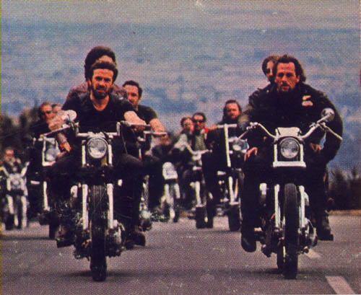

RIDER OF BMW ADVERTISEMENT
AFTER YOU GROW AS AN ADULT, THE AGE IS JUST A NUMBER.
YOU ARE NOT TOO OLD OR TOO YOUNG TO TRY SOMETHING YOU WANT TO.

Slide 7
THANK YOU

